Slide 1

Employee Management System

Slide 2

Employee Management System
Introduction
Motivation
Features
Methodology
ER-Diagram
Workflow
Use Case Diagram
Selected Screenshots
Limitation and Future Works
Conclusion
Reference
Shafayet Ullah Ramim
ID- 2104010202219
Shihabul Alam Shakib
ID- 2104010202221
Durjoy Nath
ID- 2104010202222
Md Arafat Hossen Rabby
ID- 2104010202223

Slide 3

OUTLINES
Introduction
Motivation
Features
Methodology
ER-Diagram
Workflow
Use Case Diagram
Selected Screenshots
Limitation and Future Works
Conclusion
Reference

Slide 4

INTRODUCTION
The Employee Management System (EMS) efficiently manages employee data, automating tasks like payroll, leave records, and personal information. Developed using PHP Laravel with MySQL, it offers a user-friendly interface built with HTML, CSS, and Bootstrap. EMS ensures secure, role-based access for employees, managers, and administrators, streamlining human resource management and improving productivity. By replacing manual processes, it reduces errors and enhances efficiency in organizations.

Slide 5

MOTIVATION
Strong motivation for the project:
Efficiency in Employee Data Management
Improved Accessibility
Reduced Paperwork
User-Friendly and Location-Independent

Slide 6

Features
Employee Development System Features
User Authentication
Welcome Email
Password Recovery

Slide 7

Features
Admin Dashboard
Employee Management
Attendance
Monthly Payroll
Position Management
Task Assignment
Announcements

Slide 8

Features
Employee Dashboard
Employee Management
Attendance
Monthly Payroll
Position Management
Task Assignment
Announcements
Password Recovery

Slide 9
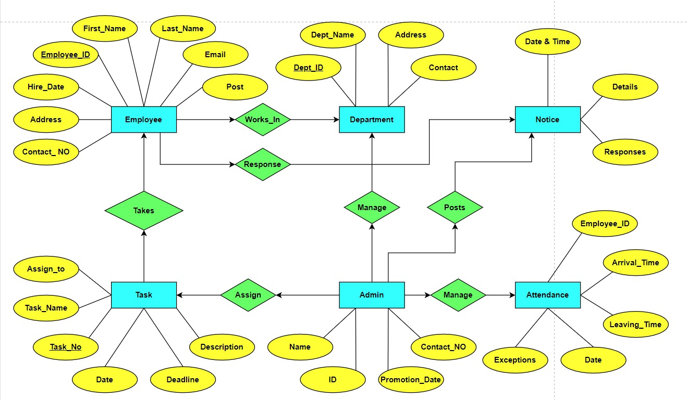
METHODOLOGY
ER Diagram

Slide 10
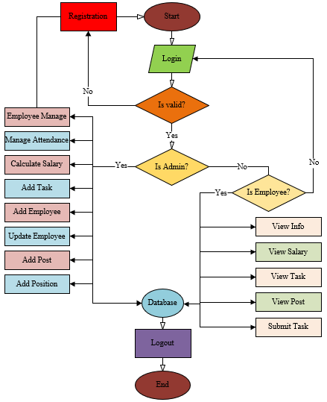


METHODOLOGY
Workflow

Slide 11
METHODOLOGY
Use Case Diagram

Slide 12
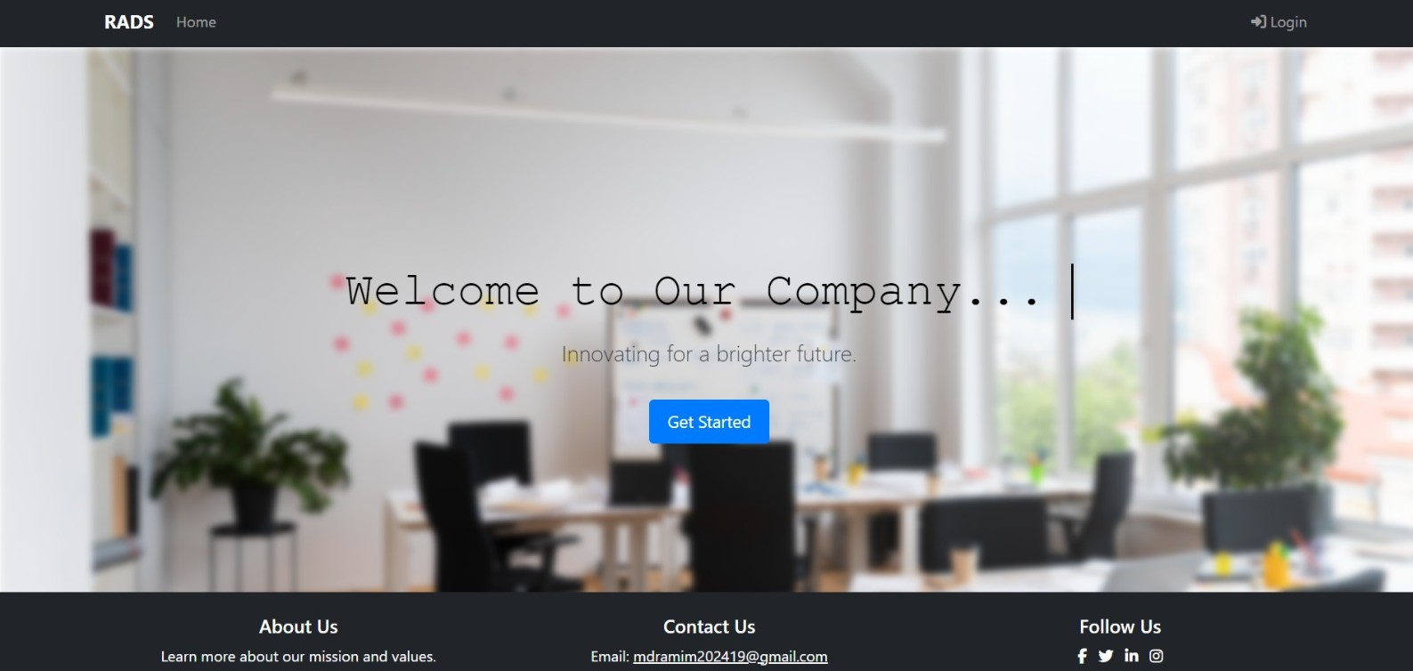
Selected SCREENSOTS
Home Page

Slide 13
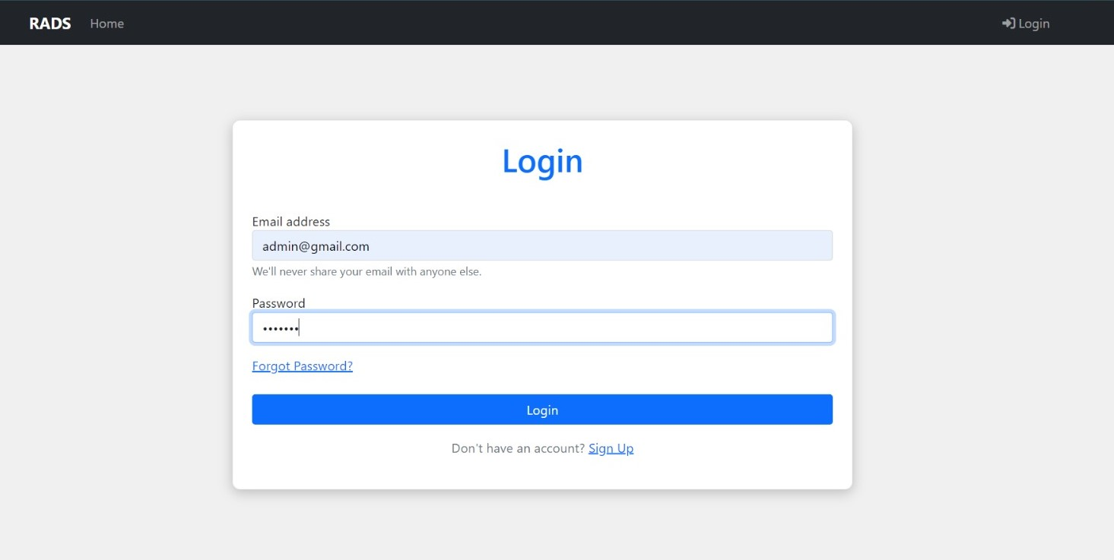
Selected SCREENSOTS
Login Page

Slide 14
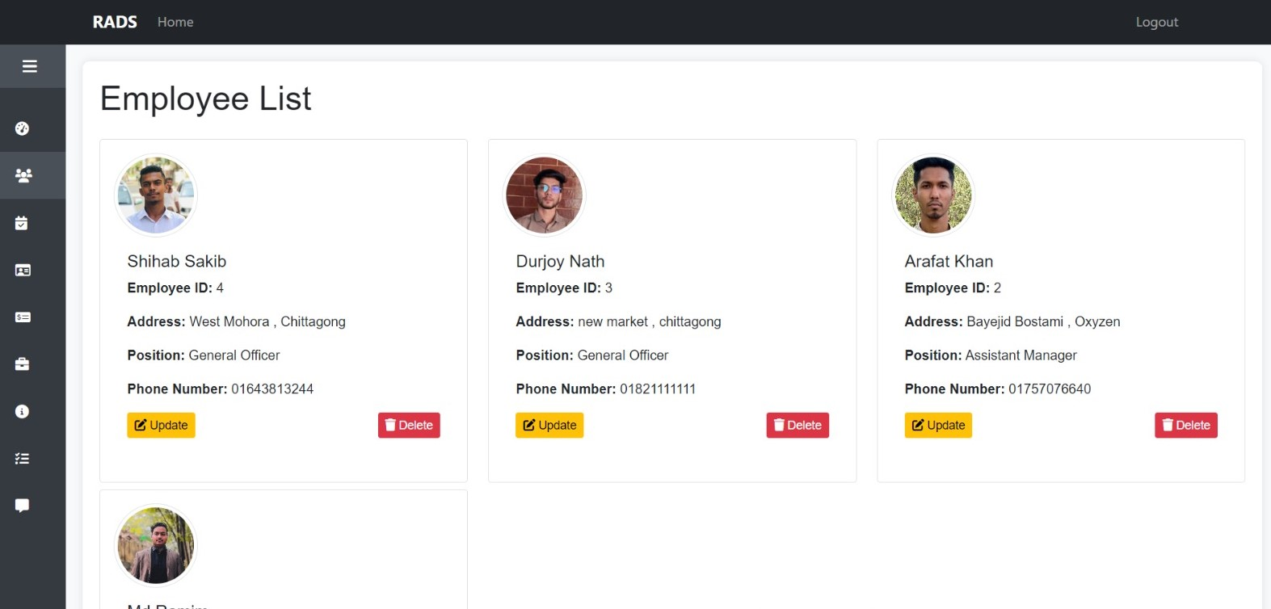
Selected SCREENSOTS
Employee List

Slide 15
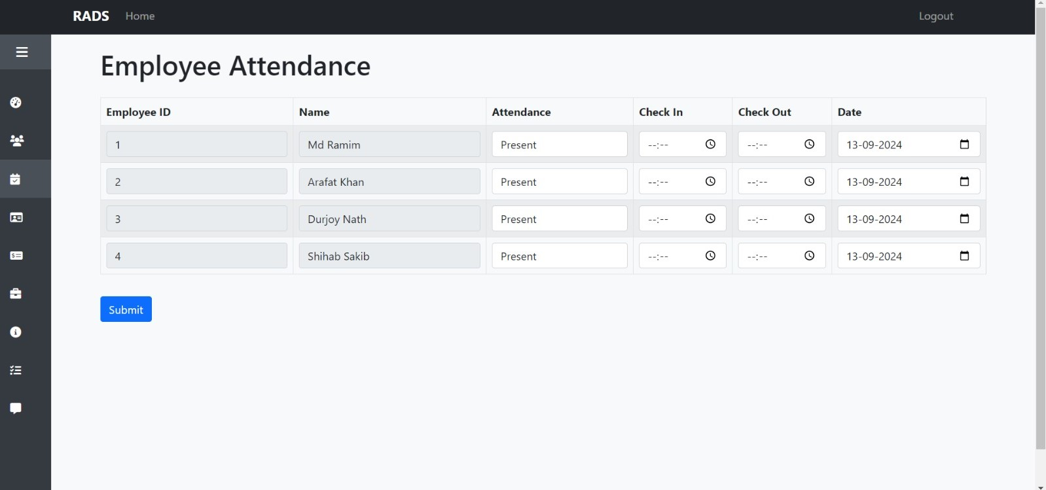
Selected SCREENSOTS
Attendance Page

Slide 16
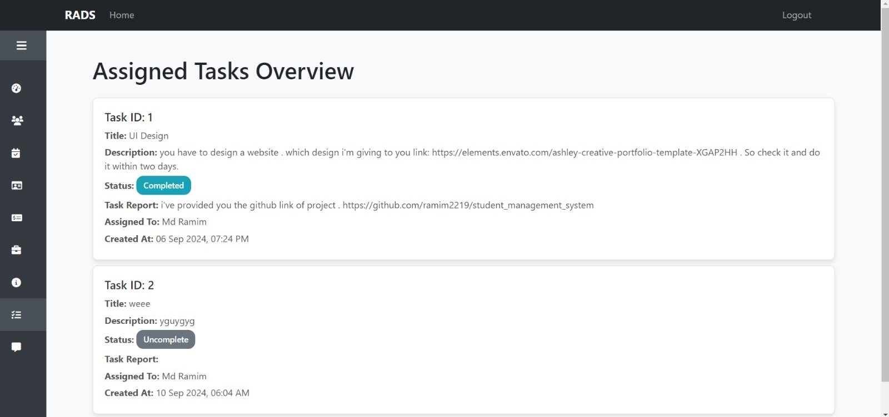
Selected SCREENSOTS
Submitted Task Page

Slide 17
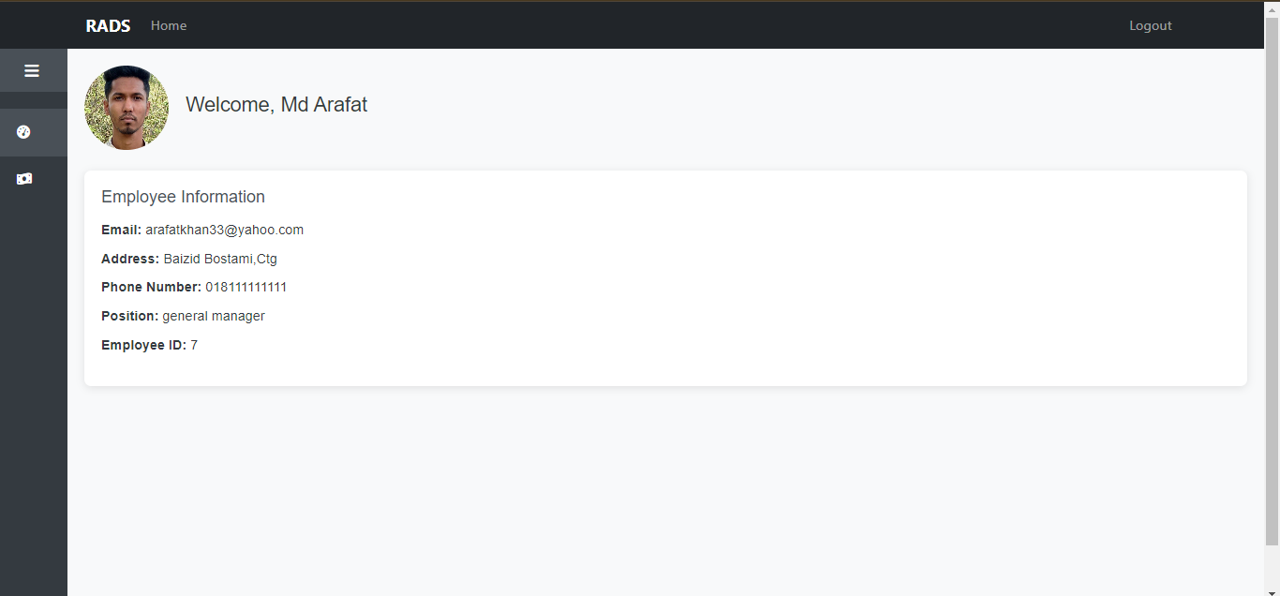
Selected SCREENSOTS
Employee Dashboard

Slide 18

LIMITATIONS
Internet Dependence
Smartphone Requirement
Limited Customization
HR Policy Variation

Slide 19

FUTURE WORKS
Advanced Reporting and Analytics
Mobile Application Development
Biometric Attendance
Employee Self-Service Portal

Slide 20

CONCLUSION
The web-based Employee Management System (EMS) simplifies employee management by replacing outdated manual processes. It efficiently handles employee data, salary, and attendance, boosting productivity and accuracy. Future updates may include features like analytics, a mobile app, and biometric attendance as the EMS grows with the business.

Slide 21

Reference
[1] K. D. Kanchev, “Employee management system,” 2006, pp. 1–65. [Online]. Available: https://lnu.diva- portal.org/smash/get/diva2:204828/FULLTEXT01.pdf
[2] E. Ansari, “Web based employee management system,” BUET, 2019. [Online]. Available: http://lib.buet.ac.bd:8080/xmlui/handle/123456789/5830
[3] P. Gloria, Available: “Employee management system,” 2012. [Online]. https://images.template.net/wp-content/uploads/2016/07/15084700/ employee-project-tracking-template-.pdf
[4] S. Thapa, “Employee management system,” 2023. [Online]. Avail able: https://srmus.ac.in/view/governance/naac/1.3.4/Supporting%20Documents/MCA/Suchana%20Thapa%2020IT103009.pdf
[5] H. k. Yash pratap singh, Yogyata nagayach, “Employee management system,” 2023. [Online]. Available: https://ymerdigital.com/uploads/YMER2205U2.pd

Slide 22


